Slide 1
NYC CitiBike Analysis
File created on: 10/9/2021 6:47:49 PM

Slide 2
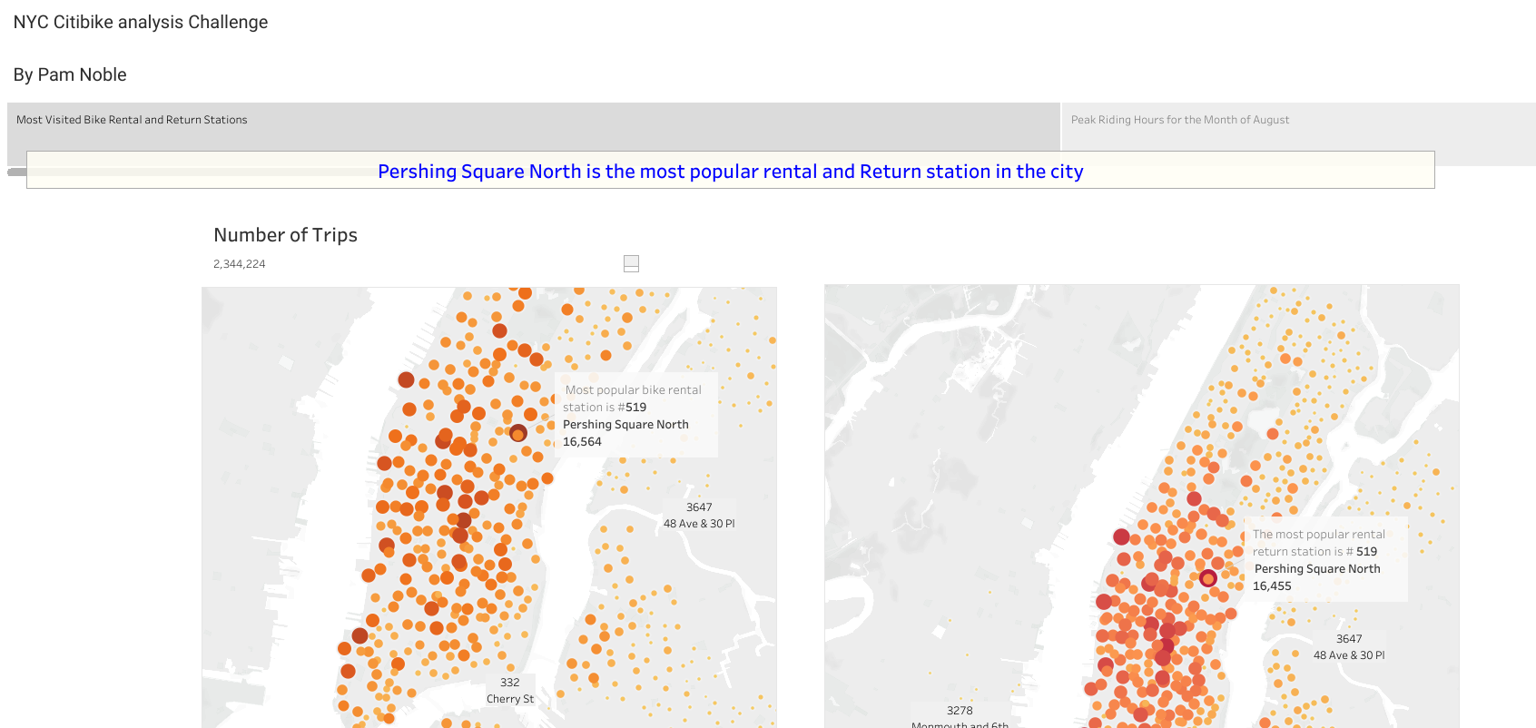

Slide 3
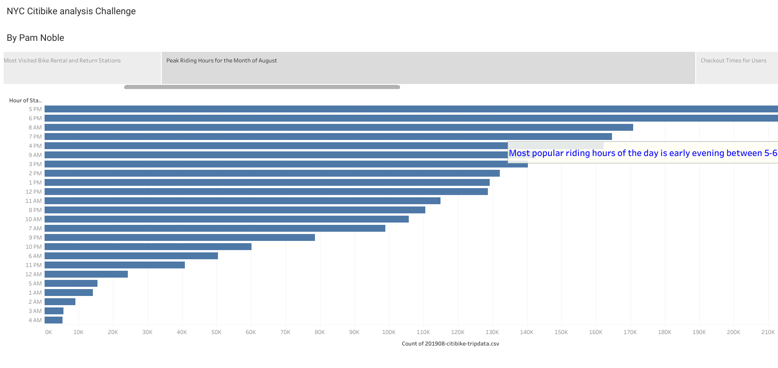

Slide 4
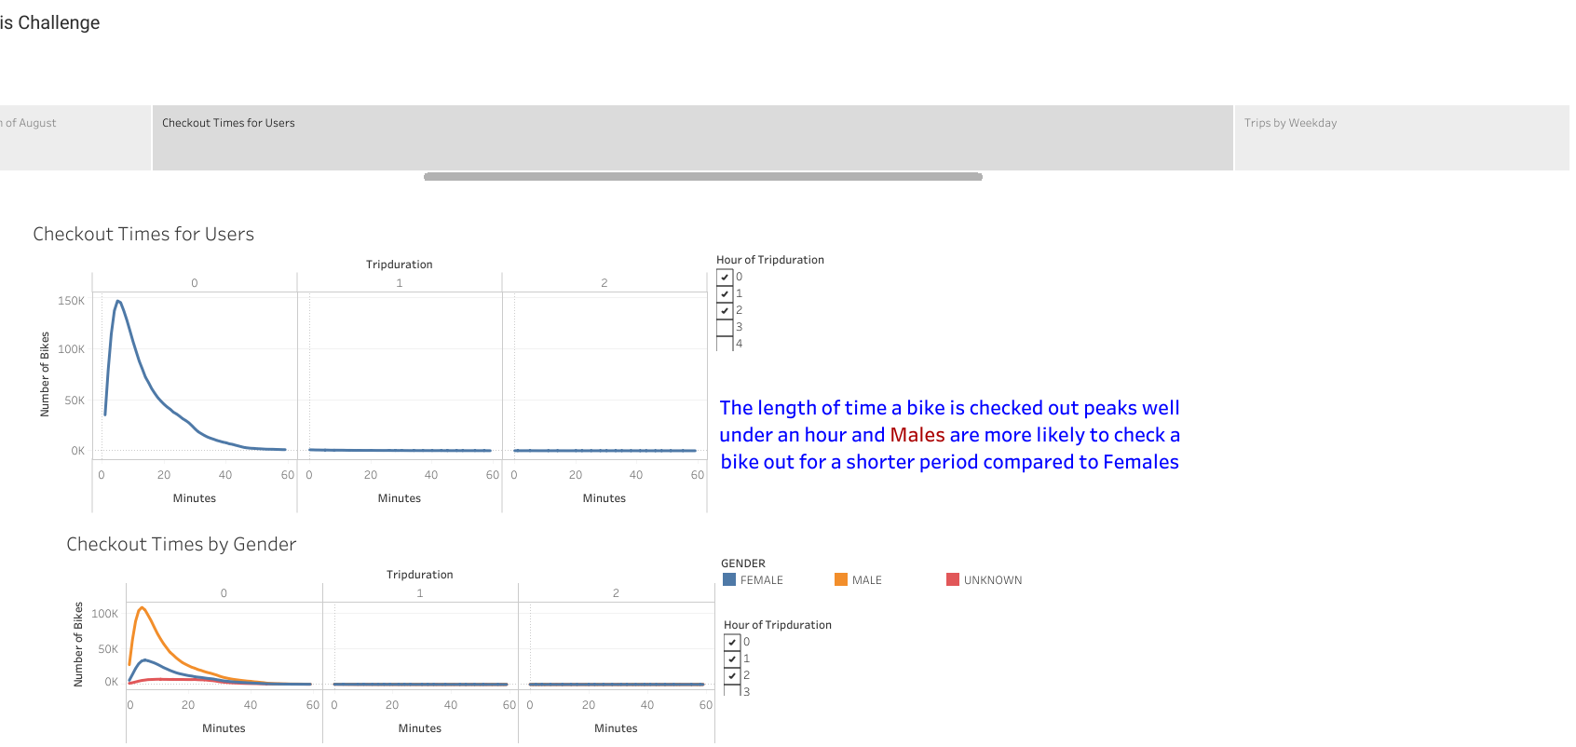

Slide 5
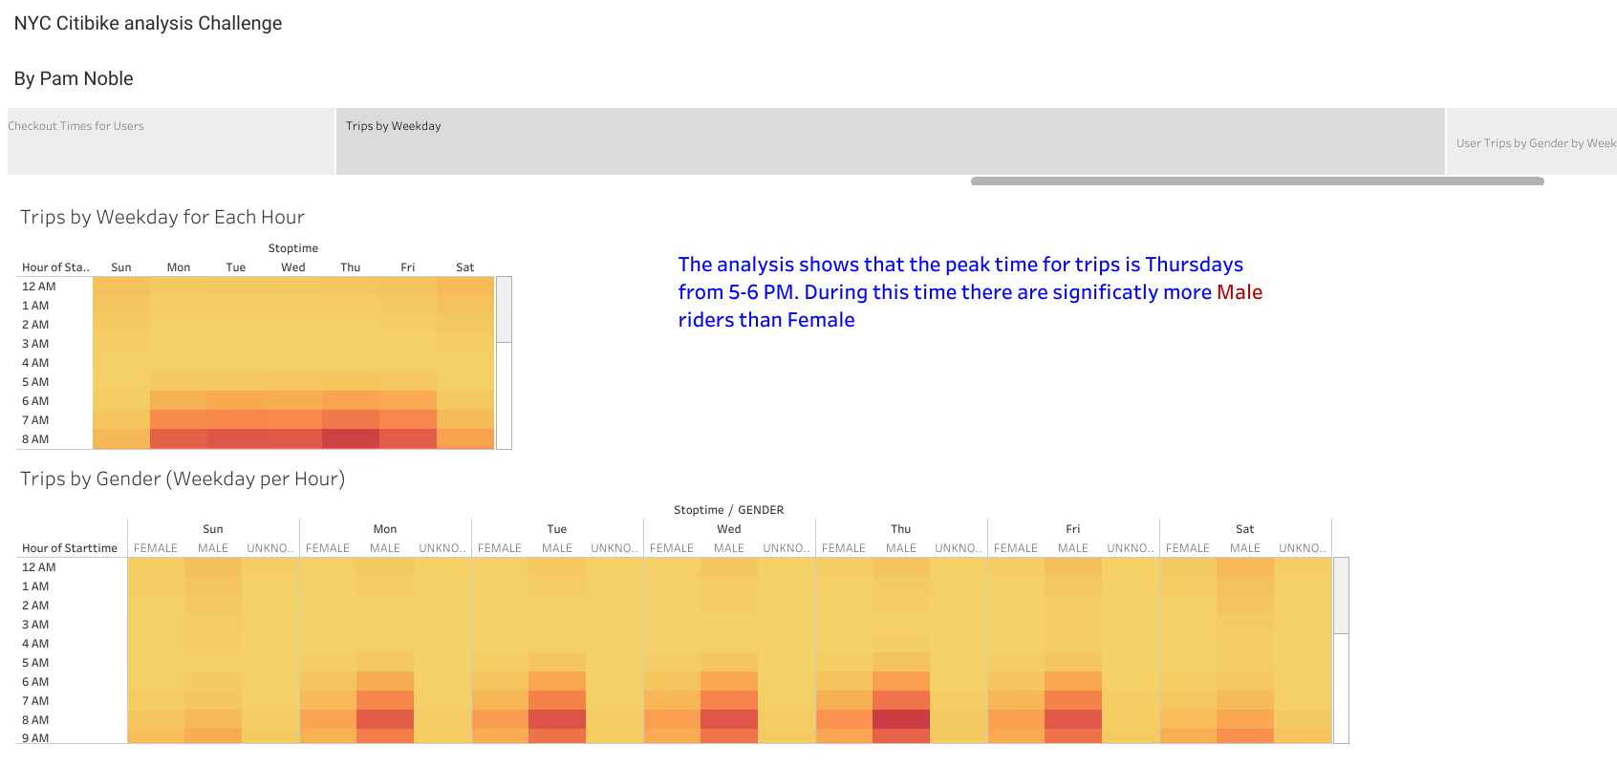

Slide 6
